Slide 1

ImmunoPterin™ – “IP™”
A Breakthrough Discovery for the
Immune System
Summary
November 12, 2018
Notes:
Good afternoon everyone, I am Dr Phil - Moheno that is President & Chief Scientist of SanRx and - the inventor of ImmunoPterin.

Slide 2
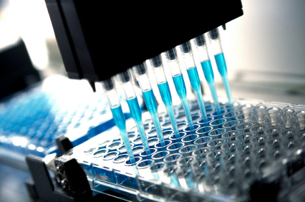
SanRx - The Pterin Pioneers
Over 40 years of pterin research
  Four international patents issued
  Two US Patents pending
  Over ten scientific publications
2004 - Invented Pterin+Calcium™, nutraceutical
2005 - Invented DCP™, pharmaceutical
2012 – Invented Calcium Folate Supplement - ImmunoPterin™ (“IP™”)
2014 – Identified new more potent calcium pterin 6-carboxylate
Notes:
History of invention – lab research at UCLA identified a blue spot, found to contain pterin – pterin, the Greek word for wing, gives butterfly wings its color.
Subsequent mouse-tumor studies at Oxnard, CSUB, patent at San Diego State;
Invented & patented Pterin+Calcium and DCP, in collaboration with the FDA, awaiting toxicology testing. A number of studies on mice for breast cancer, diabetes, HBV and TB showed calciun pterin effectiveness.
Because of supplement interest in 2011, we ”reverse engineered” our research to invent ImmunoPterin, the only know supplement designed to create pterins. With the supplement we dropped the “pharmaceuticals” from our name and became SanRx.
Now seeking funding to bolster our business team, and either enter market with ImmunoPterin or license to a partner.

Slide 3
ImmunoPterin™ chemistry
+ 250 mol excess
CaCl₂.2H₂O
aqueous

Slide 4
Calcium Folate Active Ingredient

Slide 5
ImmunoPterin™ “IP™” Produces:
Calcium pterin 6-COOH chelate - Evidence for Improvement
Indication [references] | High/Low Cytokines / from affliction | Efficacious Dose Range (mg/kg) | High/Low Th1/Th2/Th17 from affliction
In human Colds/influenza (>20/20) Cancer (various) (4/5) Osteoarthritis (10/11) | Complex Complex,↑IL-6 ↑TGFβ,↑IL-1β | ImmunoPterin 0.007 0.007 0.002 | ↑Th1,↑Th2,↑Th17, ↕Treg ↓Th1,↑Th2,↑Th17,↑Treg ↑Th1,↑Th2,↑Th17
Efficacy Model | Δ Cytokines from efficacious treatment | Efficacious Dose Range (mg/kg) | Δ Th1/Th2/Treg @ efficacious dosages
In vivo MDA-MBA-231 nude mice | ↑IL-12→↕Th1: ↓IFNγ ↑IL-4→↑Th2: ↑IL-4 ↑Treg: ↑IL-10 Others: ↓IL-6 | 7 - 69 CaPterin, DCP | ↕Th1,↑Th2,↑Treg

Slide 6
Immune System Support Opportunity
Disease (Major indications)
  $185.5 Billion on osteoarthritis/yr (US 2009)
  $300 Million on cold/flu prevention (US 2013)
  $125 Billion spent on cancer/yr (US 2010)
General Immune Support
  Increasing consumer focus on immune health
  Currently there is a spectrum of products on the market, none with pterin, known to enhance the immune system (Th2 cells), with no side effects and inexpensive
Notes:
Awareness of the importance of immune system health has increased as people realize its role in everything from reducing the risk of illness and chronic disease to staving off other physical implications of aging.
Many market experts feel immune support is poised for significant growth and new solutions appear in this category frequently. ImmunoPterin is the only known supplement designed to produce pterins, known to inhibit IDO (indoleamine 2,3-dioxygenase), which we will go into in a moment.

Slide 7

The IP™ Opportunity
Adjuvant applications for patients
  with compromised immune systems and
  for general immune support
Competing immune enhancing solutions
  Very few proven herbs and supplements
  SanRx approach only one harnessing pterins, with broad, effective application without side effects
Improved IP costs < 35¢ a dose
Notes:
The SanRx pterin approach is unique, effectively targeting IDO.
Our research and publications have documented our approach is effective against cancerous tumors, diabetes, TB, and hepatitis B, as well as for general immune support.
A handful of competitors offer IDO inhibitor solutions that may be either too harsh or limited in effectiveness. ImmunoPterin offers a broad-based application without harmful side effects at a very reasonable cost.

Slide 8
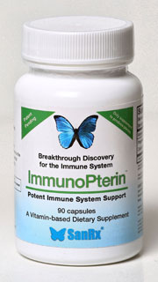
IP™ – First Therapeutic Pterin
“[This] will be the first simple pteridine derivative on the market and there is hope that it will find people who will benefit from it.” - Dr. Wolfgang Pfleiderer, University of Konstanz, Germany
Safe, tasteless, absorbable powder
– capsules or liquid
Clinical trials in osteoarthritis
in progress
Notes:
Pull bottle out of your pocket
We began sampling ImmunoPterin September 1st and one of the first to receive a sample was our colleague Dr. Wolfgang Pfleiderer, the godfather of pteridine chemistry. We are very gratified by his support.
Pterins are produced by the body – everyone has them. Our suggested dosage is 3 capsules a day for compromised systems, one for general immune maintenance.
Please see me if you are interested in a sample.

Slide 9
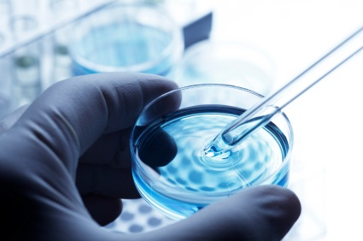
What SanRx Needs
  Move IP™ from development to production
  Expand patent coverage; Optimize the team; invest in sales and marketing
  Ongoing product development , testing and patenting
Notes:
What we are seeking today is a $1.9 million dollar investment to take SanRx to the next level, to either partner with a manufacturer or ramp up production.
We want to expand the product line with continued testing and development of Pterin+Calcium and DCP, and add sales and marketing leadership.

Slide 10
ImmunoPterin™ - IP™
The First Therapeutic Pterin
Potent Immune System Support
Notes:
We know SanRx has the potential to redefine the immune support market starting with ImmunoPterin, but more importantly, to help many people achieve greater health and well being.
Thank you very much.

Slide 11
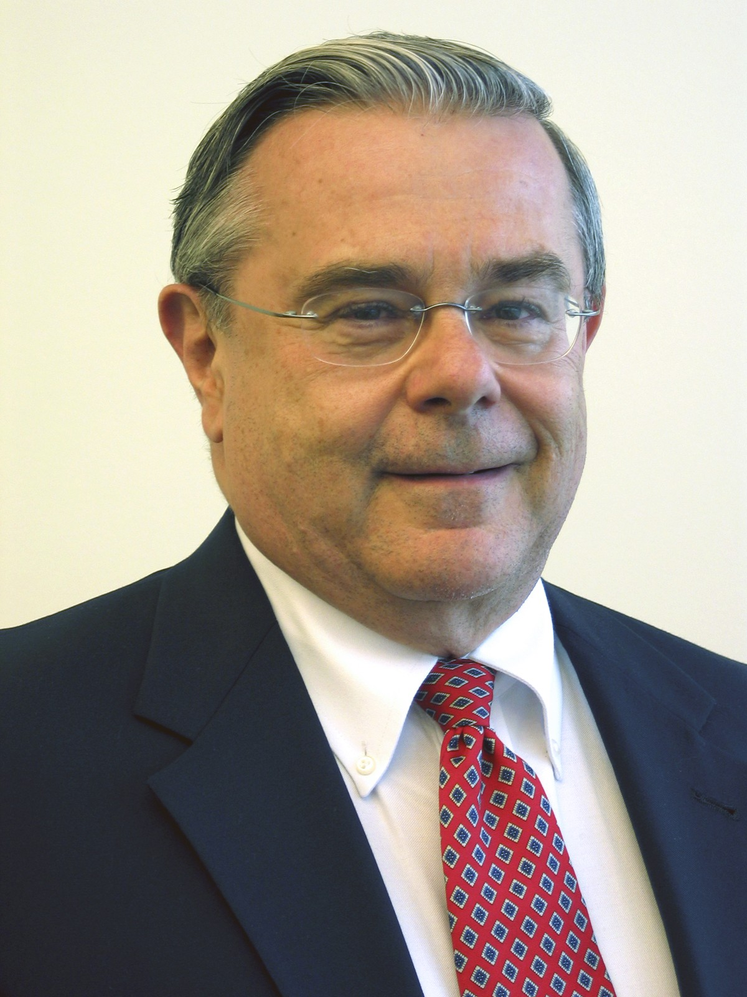
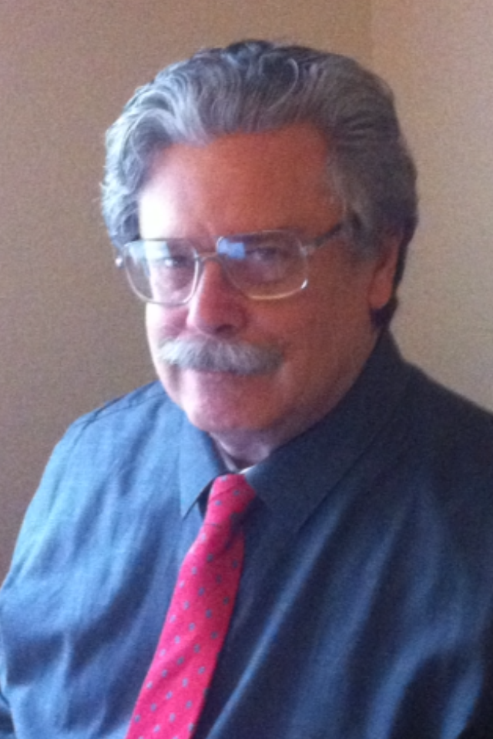
SanRx Team
Highly experienced Scientific Team
  100+ combined years experience in biochemistry, applied research, Intellectual Property
Scientific Advisory Board
  United States, Austria, Germany
Business Advisory Board
  Business development, finance, marketing, nutraceutical
Berkey
BerkeyMoheno
Notes:
SanRx management team consists of Dr. Edgar Berkey, who has numerous qualifications, including President and Co-Founder of the Center for Hazardous Materials Research, and the National Environmental Technology Applications Corporation; Manager and Senior Research Scientist at Westinghouse Research Laboratories; he holds a PhD in engineering physics from Cornell, a BS in chemical engineering from Stanford, and an Executive MBA from the University of Pittsburgh.
My background includes a BS and C.Phil. in Biochemistry from UCLA and a doctorate from UC Santa Barbara. I have 10 publication and four patents on pterins.
The SanRx scientific advisory team includes world-class thought leaders in pteridine chemistry here and in Europe. Our San Diego-based business advisory board includes members with business, nutraceutical, financial, and marketing backgrounds.
Our team now needs to expand, and proceeds will go to add business and marketing leadership.

Slide 12

Scientific Advisors
Dietmar Fuchs Ph.D. – Medical Chemistry, Innsbruck Medical University, Austria
Stephen Chang, Ph.D. – SanRx Consultant
Boris Minev MD – Director of Tumor Immunology, UCSD Moores Cancer Center
James C. Ryan Ph.D. - UC San Francisco, Immunology
Wolfgang Pfleiderer Ph.D. – Prof. of Chemistry, Univ. of Stuttgart and Konstanz in Germany
Arnold L. Rheingold Ph.D. - UC San Diego, Chemistry & Biochemistry
Antonio G. DiPasquale Ph.D. - UC Berkeley, Chemistry & Biochemistry
John D. Morrey Ph.D. - Institute for Antiviral Research, Utah State University
Daniel F. Hoft MD Ph.D. – Saint Louis Univ., Immunobiology, Internal Medicine, & Microbiology
Svetlana Nikoulina Ph.D. – Director of Preclinical Research & Development, SanRx
Jeffrey T. Taylor, DMD, MBA - Northwest Clinical Research Consultants, Inc.
For further details visit www.sanrx.com and www.immunopterin.com .

